Slide 1

Digital Signal Processing Laboratory Musical Scale/Raga Detection Using MATLAB By: Nithin N_ENG18EC0072
Dayananda Sagar University
Department of Electronics and Communication Engineering

Slide 2
CONTENTS:
Objectives
Introduction
Implementation
Code
Execution using MATLAB
Result
Application
Conclusion
References

Slide 3
Literature Survey
Raga is identified on basis of Arohana-Avarohana, Pakad, Gamakas, Swara, Vadi, etc.
A brief Introduction to raga is being discussed.
Database containing ragas to obtain a better and more accurate result.
Manual detection of tonic.

Slide 4
OBJECTIVES:
To find the scale/raga from the given audio file.
To perform raga recognition on a set of ragas and collected database of these ragas played in instrument.

Slide 5
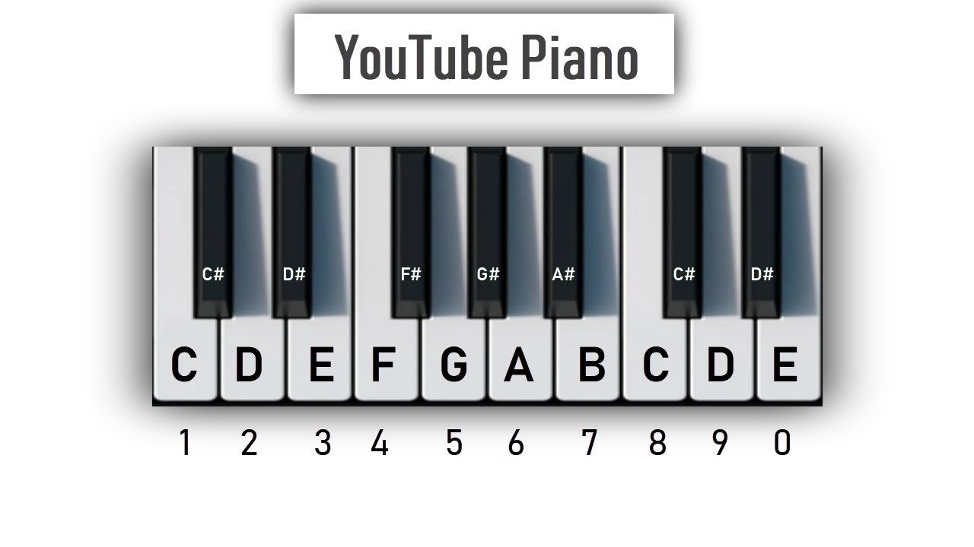
INTRODUCTION:
Sound wave is made up of vibrations
Each note is represented by Sa Ri Ga Ma Pa Da Ni Sa(Indian) or C D E F G A B C(Western)
Including the semitones there are 12 main note i.e
"S","R1","R2","G2/R3","G3","M1","M2","P","D1","D2/N1","N2/D3","N3","S"
Each Raga has mainly seven notes i.e Saptha Swaras eg:
There are 72 Melakartha ragas in Carnatic music
This Swara is nothing but frequency
Ex: A4= 440Hz A5= 880Hz
Dheera Shankarābharanam | S R₂ G₃ M₁ P D₂ N₃ Ṡ

Slide 6
Creating the database using binary weights
S R1 G1/R2 G2/R3 G3 M1 M2 P D1 D2/N1 N2/D3 N3
1 1 1 0 0 1 0 1 1 1 0 0
Consider the raga : Kanakāngi(Janaka raga) | S R₁ G₁ M₁ P D₁ N₁ Ṡ
(111001011100)2=(3164)10

Slide 7
Database
name=["kanakangi","ratnangi","ganamoorti","vanaspati","manavati","tanaroopi","senavati","hanumatodi","dhenuka","natakapriya","kokilapriya","rupavati","gayakapriya","vakulabharanam","mayamalava gowla","chakravakam","sooryakantam","hatakambari","jhankaradhvani","natabhairavi","keeravani","kharaharapriya","gowri manohari","varunapriyaa","mararanjani","charukeshi","sarasangi","harikambhoji","dheera shankarabharanam","naganandhini"];
values=[3164,3162,3161,3158,3157,3155,3420,3418,3417,3414,3413,3411,3292,3290,3289,3286,3285,3283,2908,2906,2905,2902,2901,2899,2780,2778,2777,2774,2773,2771];

Slide 8
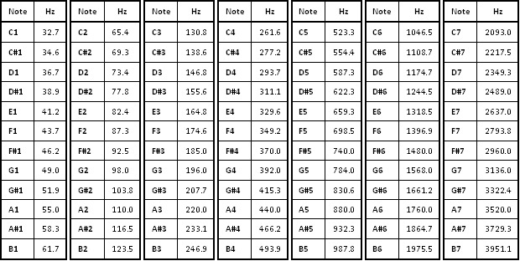

Slide 9
PITCH NAMING FUNCTION function [y,n]=pitchname(x,fs)
The ratio of adjacent notes in piano is 2*(1/12)
The frequency change in piano is in geometric series
The standard frequency reference is
A=440Hz
f =440•2^(n /12)
Hence to find the notation we use
function [y,n]=pitchname(f)
Notation=["A","A#","B","C","C#","D","D#","E","F","F#","G","G#","A"];
n=log2(f/440)*12;
n=round(abs(mod(n,12)))+1;
y=Notation(n)+join(string(floor(f/440)+4));
end

Slide 10
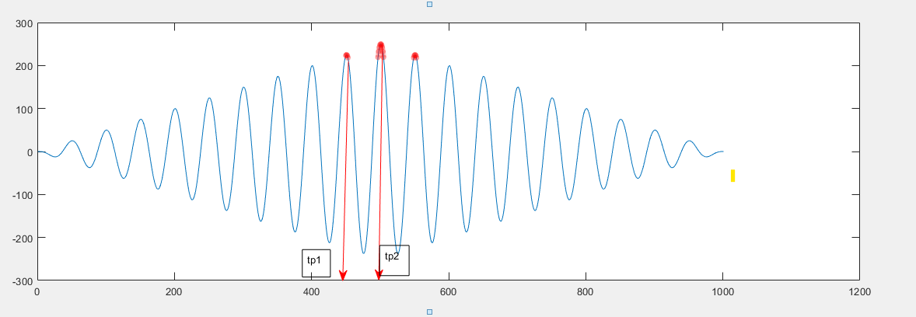
Finding the pitch/frequency using autocorrelation function
Characteristics of autocorrelation function
It has highest amplitude at the origin
The difference between the two prominent peaks gives the time period.
T=tp(1)-tp(2)
F=1/t

Slide 11
function f=freqcorr(song,fs)
function f=freqcorr(song,fs)
temp=xcorr(song);
[p0,t]=findpeaks(temp);
[m,peaks]=max(p0);
f=fs/(t(peaks+1)-t(peaks));
end

Slide 12
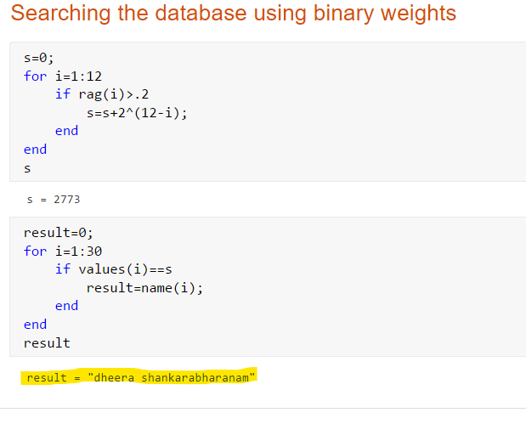

Slide 13
Application
Allows user to search for a raga from its Swaras(notes)
It also provides Arohana(Ascending scale) and Avarohanm(Descending scale) for each raga.

Slide 14
Conclusion and Future Work:
A brief introduction to raga and its characteristics is discussed
Techniques for identifying of raga are investigated with their database
Methods of implementation using MATLAB and parameters are discussed
Proposing a well defined and robust technique for raga recognition which gives maximum accuracy and expanding our database to many more ragas.

Slide 15
References:
https://en.wikipedia.org/wiki/List_of_Janya_rag
https://en.wikipedia.org/wiki/Piano_key_frequenciesas

Slide 16
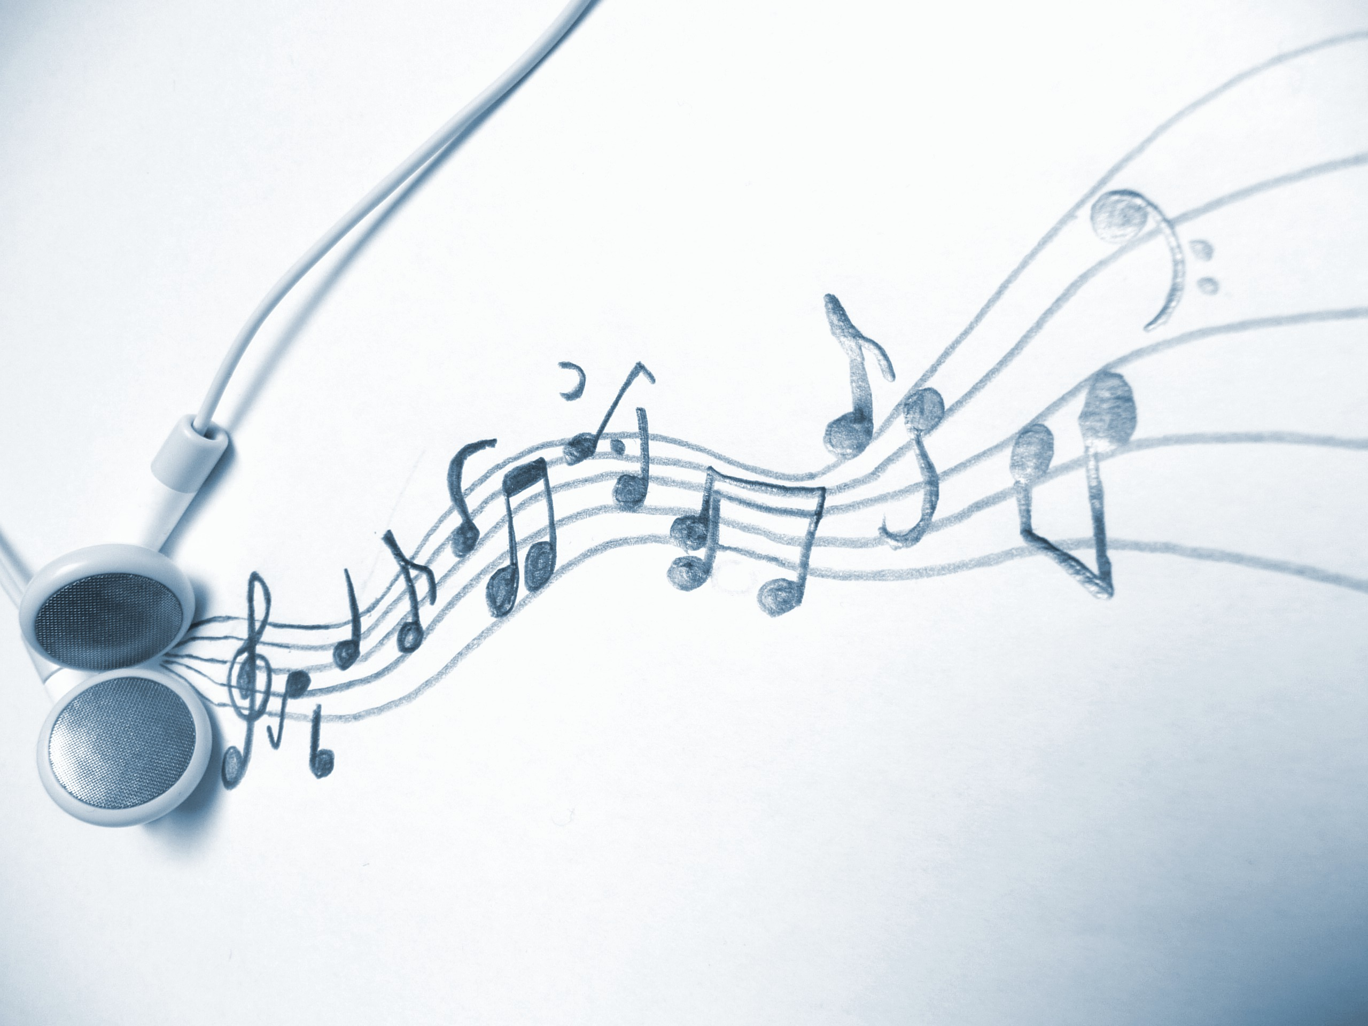

This Photo by Unknown Author is licensed under CC BY

